Slide 1
Vector Spaces
LINEARLY INDEPENDENT SETS; BASES

Slide 2
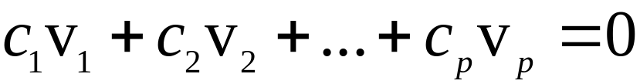
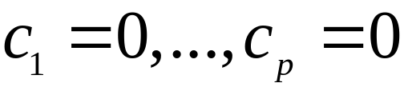
LINEAR INDEPENDENT SETS; BASES
An indexed set of vectors {v₁, …, v_{p}} in V is said to be linearly independent if the vector equation
----(1)
has only the trivial solution, .
The set {v₁, …, v_{p}} is said to be linearly dependent if (1) has a nontrivial solution, i.e., if there are some weights, c₁, …, c_{p}, not all zero, such that (1) holds.
In such a case, (1) is called a linear dependence relation among v₁, …, v_{p.}

Slide 3


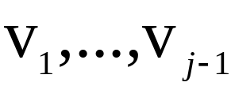
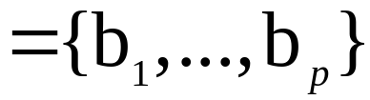
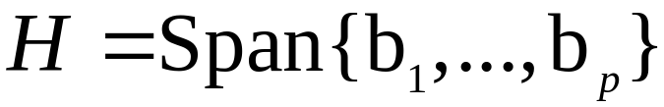
LINEAR INDEPENDENT SETS; BASES
Theorem 4: An indexed set {v₁, …, v_{p}} of two or more vectors, with , is linearly dependent if and only if some v_{j} (with ) is a linear combination of the preceding vectors, .
Definition: Let H be a subspace of a vector space V. An indexed set of vectors  in V is a basis for H if
    (i)  is a linearly independent set, and
    (ii) The subspace spanned by  coincides with H; that is,

Slide 4


LINEAR INDEPENDENT SETS; BASES
The definition of a basis applies to the case when , because any vector space is a subspace of itself.
Thus a basis of V is a linearly independent set that spans V.
When , condition (ii) includes the requirement that each of the vectors b₁, …, b_{p} must belong to H, because Span {b₁, …, b_{p}} contains b₁, …, b_{p}.

Slide 5

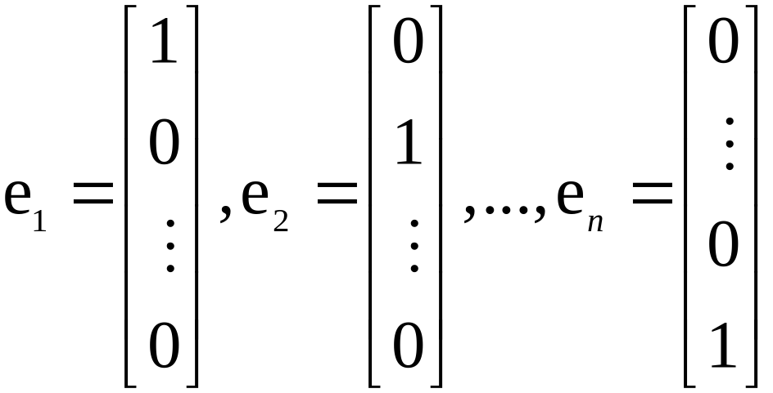

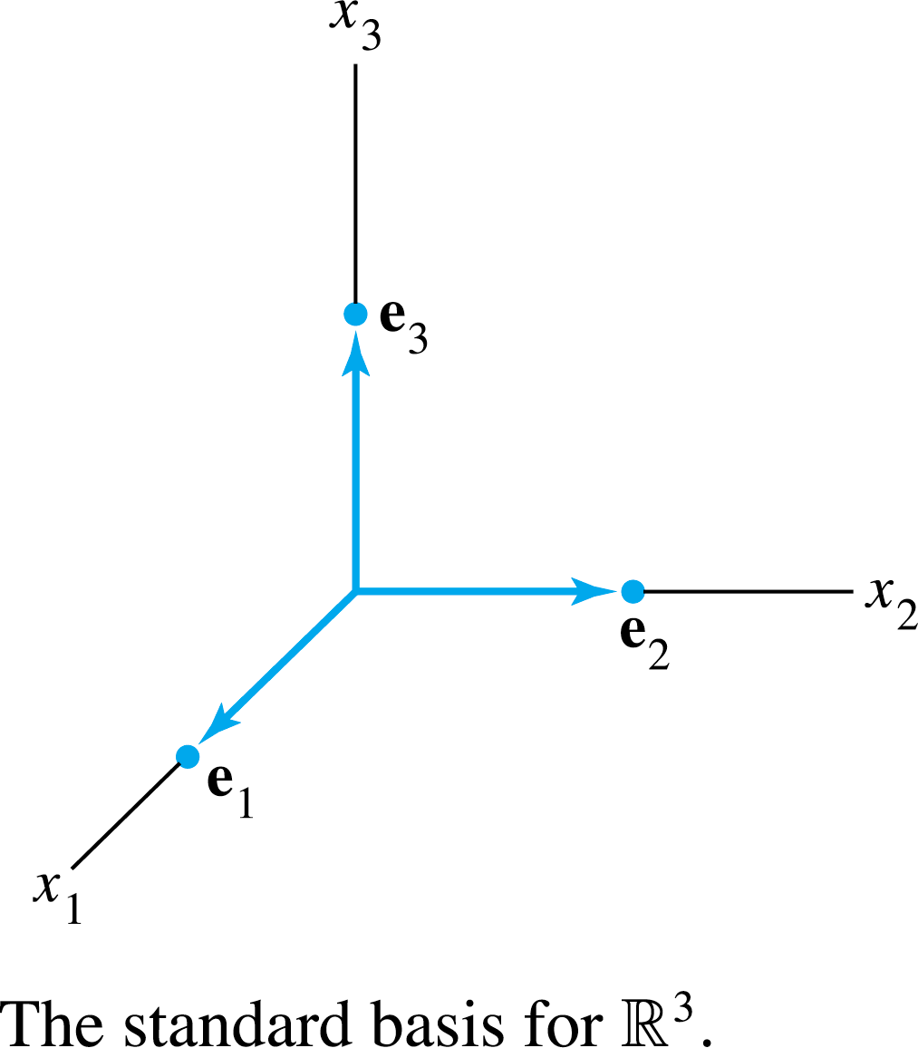
STANDARD BASIS
Let e₁, …, e_{n} be the columns of the matrix, I_{n}.
That is,
The set {e₁, …, e_{n}} is called the standard basis for . See the following figure.

Slide 6
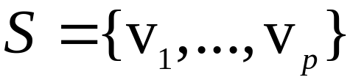
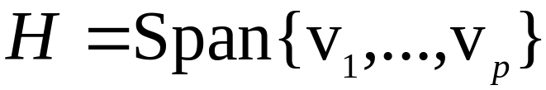

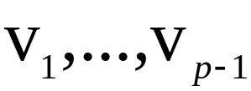
THE SPANNING SET THEOREM
Theorem 5: Let be a set in V, and let .
    If one of the vectors in S—say, v_{k}—is a linear combination of the remaining vectors in S, then the set formed from S by removing v_{k} still spans H.
    If , some subset of S is a basis for H.
Proof:
    By rearranging the list of vectors in S, if necessary, we may suppose that v_{p} is a linear combination of —say,

Slide 7
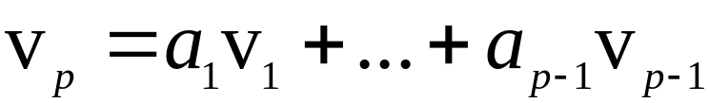
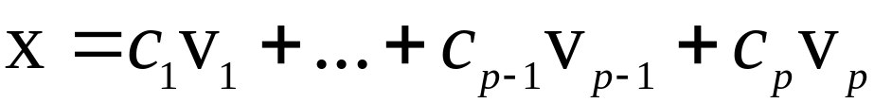
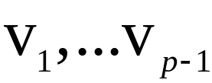
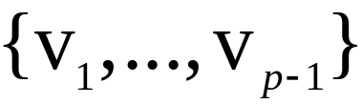
THE SPANNING SET THEOREM
----(2)
      Given any x in H, we may write
----(3)
      for suitable scalars c₁, …, c_{p}.
      Substituting the expression for v_{p} from (2) into (3), it is easy to see that x is a linear combination of .
      Thus spans H, because x was an arbitrary element of H.

Slide 8

THE SPANNING SET THEOREM
    If the original spanning set S is linearly independent, then it is already a basis for H.
      Otherwise, one of the vectors in S depends on the others and can be deleted, by part (a).
      So long as there are two or more vectors in the spanning set, we can repeat this process until the spanning set is linearly independent and hence is a basis for H.
      If the spanning set is eventually reduced to one vector, that vector will be nonzero (and hence linearly independent) because .

Slide 9
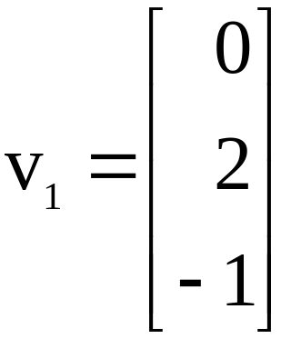
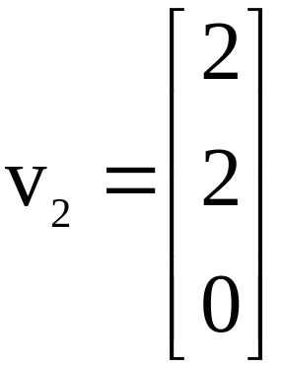
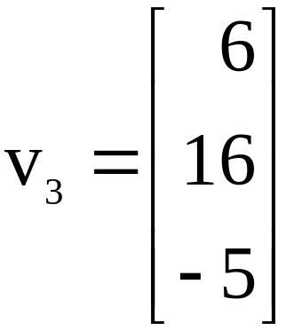
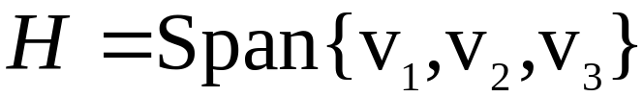
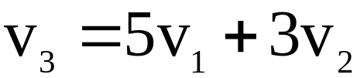
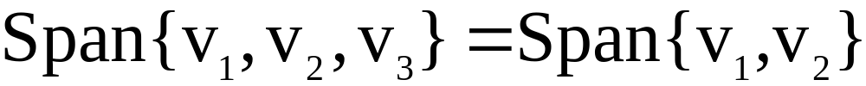
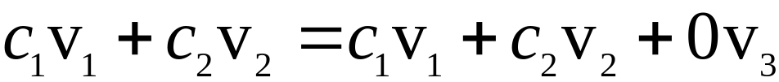
THE SPANNING SET THEOREM
Example 1: Let , ,
and .
Note that , and show that
. Then find a basis for the subspace H.
Solution: Every vector in Span {v₁, v₂} belongs to H because

Slide 10
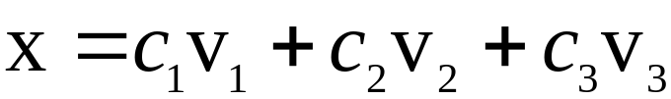
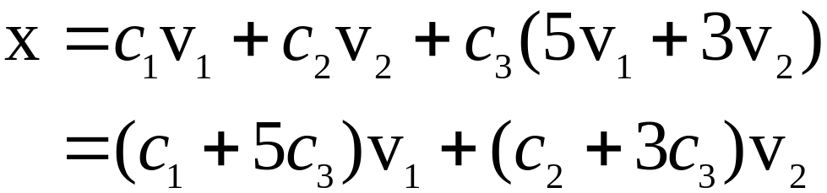
THE SPANNING SET THEOREM
Now let x be any vector in H—say,
.
Since , we may substitute
Thus x is in Span {v₁, v₂}, so every vector in H already belongs to Span {v₁, v₂}.
We conclude that H and Span {v₁, v₂} are actually the set of vectors.
It follows that {v₁, v₂} is a basis of H since {v₁, v₂} is linearly independent.

Slide 11
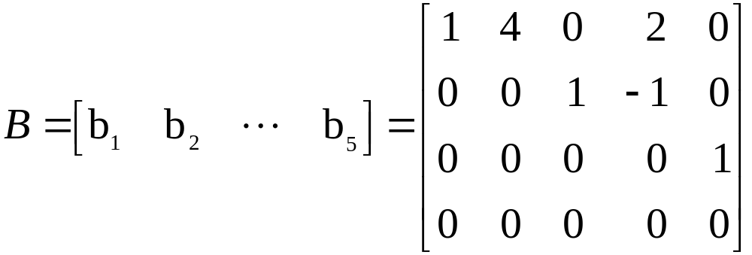


BASIS FOR COL B
Example 2: Find a basis for Col B, where
Solution: Each nonpivot column of B is a linear combination of the pivot columns.
In fact, and .
By the Spanning Set Theorem, we may discard b₂ and b₄, and {b₁, b₃, b₅} will still span Col B.

Slide 12
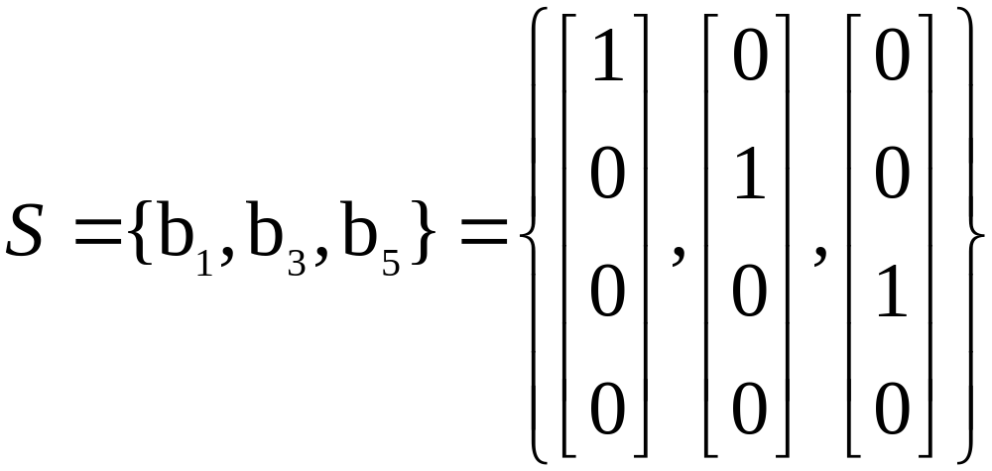

BASIS FOR COL B
Let
Since and no vector in S is a linear combination of the vectors that precede it, S is linearly independent. (Theorem 4).
Thus S is a basis for Col B.

Slide 13
BASES FOR NUL A AND COL A
Theorem 6: The pivot columns of a matrix A form a basis for Col A.
Proof: Let B be the reduced echelon form of A.
The set of pivot columns of B is linearly independent, for no vector in the set is a linear combination of the vectors that precede it.
Since A is row equivalent to B, the pivot columns of A are linearly independent as well, because any linear dependence relation among the columns of A corresponds to a linear dependence relation among the columns of B.

Slide 14
BASES FOR NUL A AND COL A
For this reason, every nonpivot column of A is a linear combination of the pivot columns of A.
Thus the nonpivot columns of a may be discarded from the spanning set for Col A, by the Spanning Set Theorem.
This leaves the pivot columns of A as a basis for Col A.
Warning: The pivot columns of a matrix A are evident when A has been reduced only to echelon form.
But, be careful to use the pivot columns of A itself for the basis of Col A.

Slide 15
BASES FOR NUL A AND COL A
Row operations can change the column space of a matrix.
The columns of an echelon form B of A are often not in the column space of A.
Two Views of a Basis
When the Spanning Set Theorem is used, the deletion of vectors from a spanning set must stop when the set becomes linearly independent.
If an additional vector is deleted, it will not be a linear combination of the remaining vectors, and hence the smaller set will no longer span V.

Slide 16
TWO VIEWS OF A BASIS
Thus a basis is a spanning set that is as small as possible.
A basis is also a linearly independent set that is as large as possible.
If S is a basis for V, and if S is enlarged by one vector—say, w—from V, then the new set cannot be linearly independent, because S spans V, and w is therefore a linear combination of the elements in S.

